Slide 1
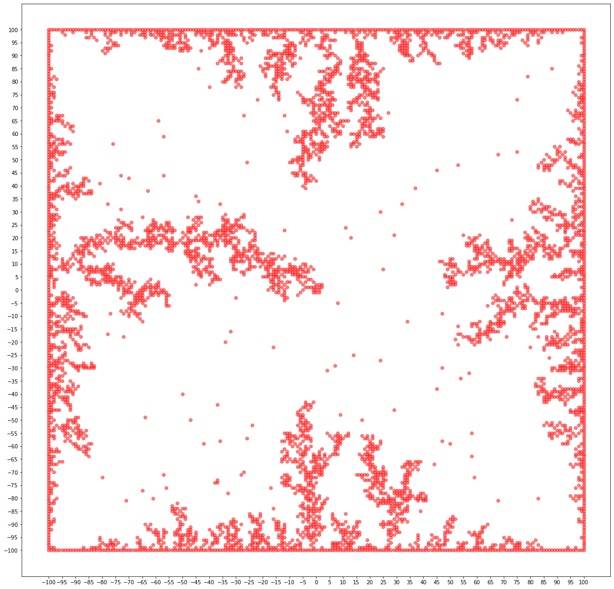
Diffusion Limited Aggregation
Paul Zebarth
Physics 4611
Computational Physics
Final Project
Notes:
My name is Paul Zebarth. Welcome and thank you for coming to my presentation on diffusion limited aggregation.

Slide 2
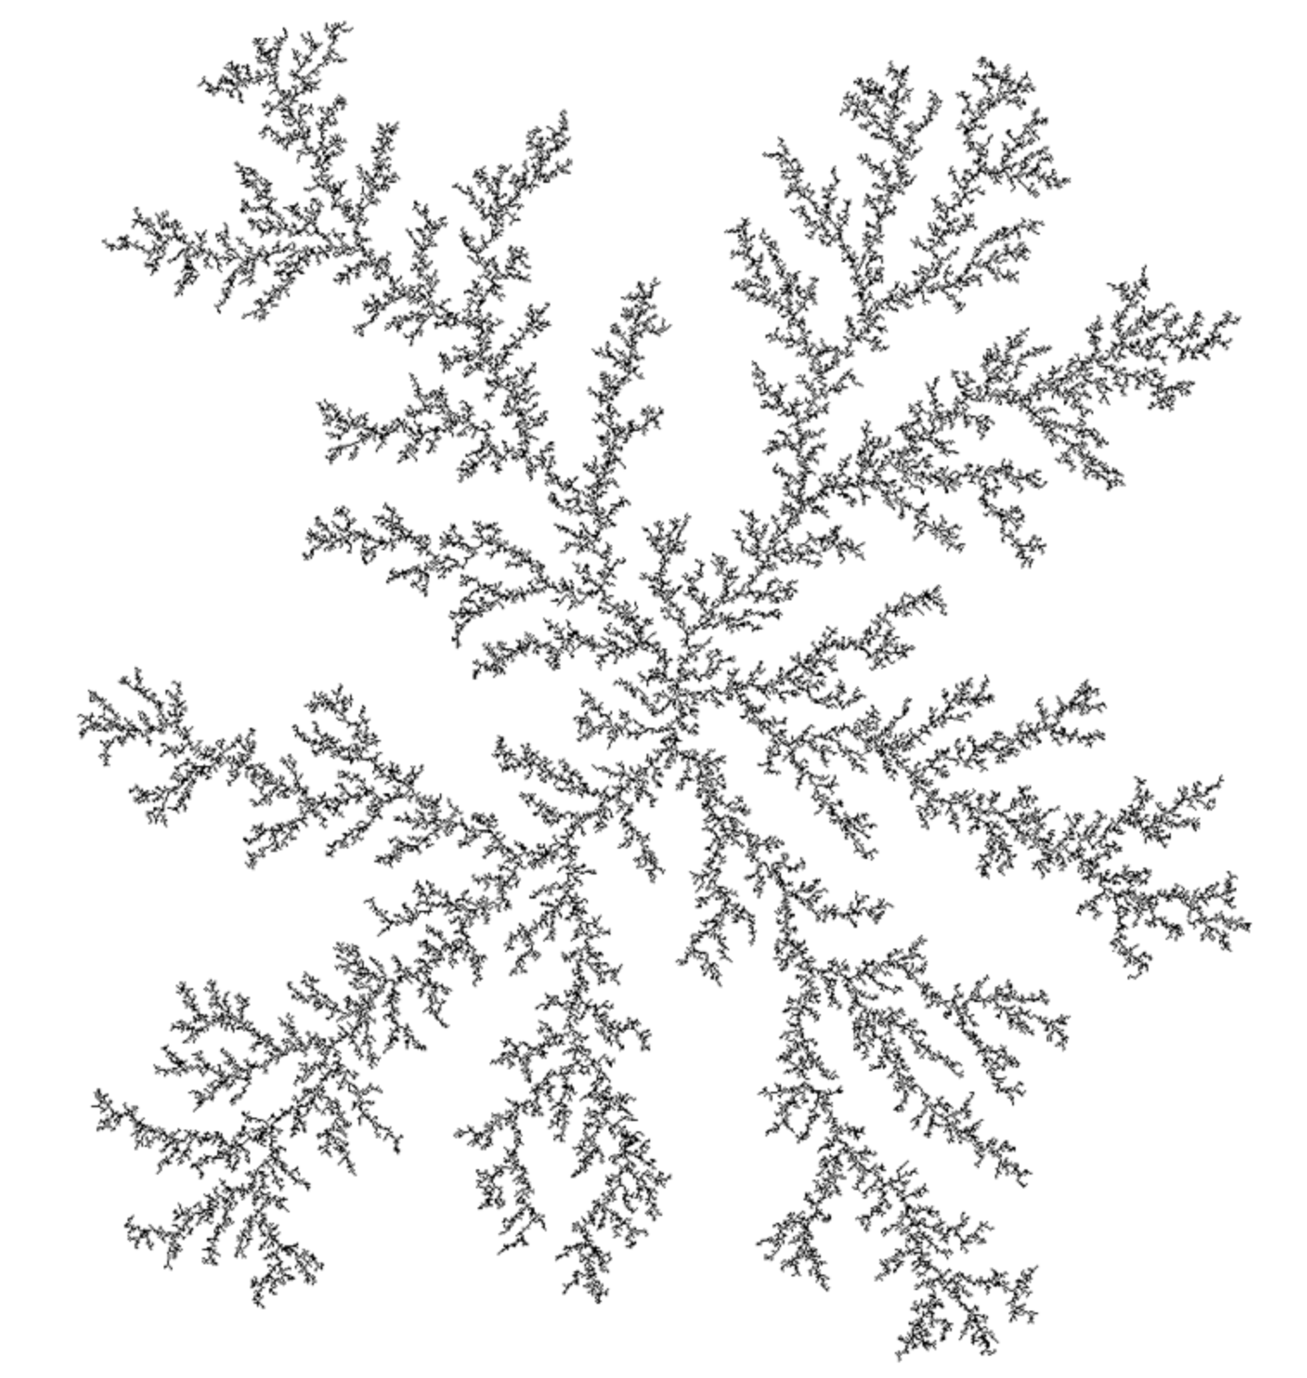
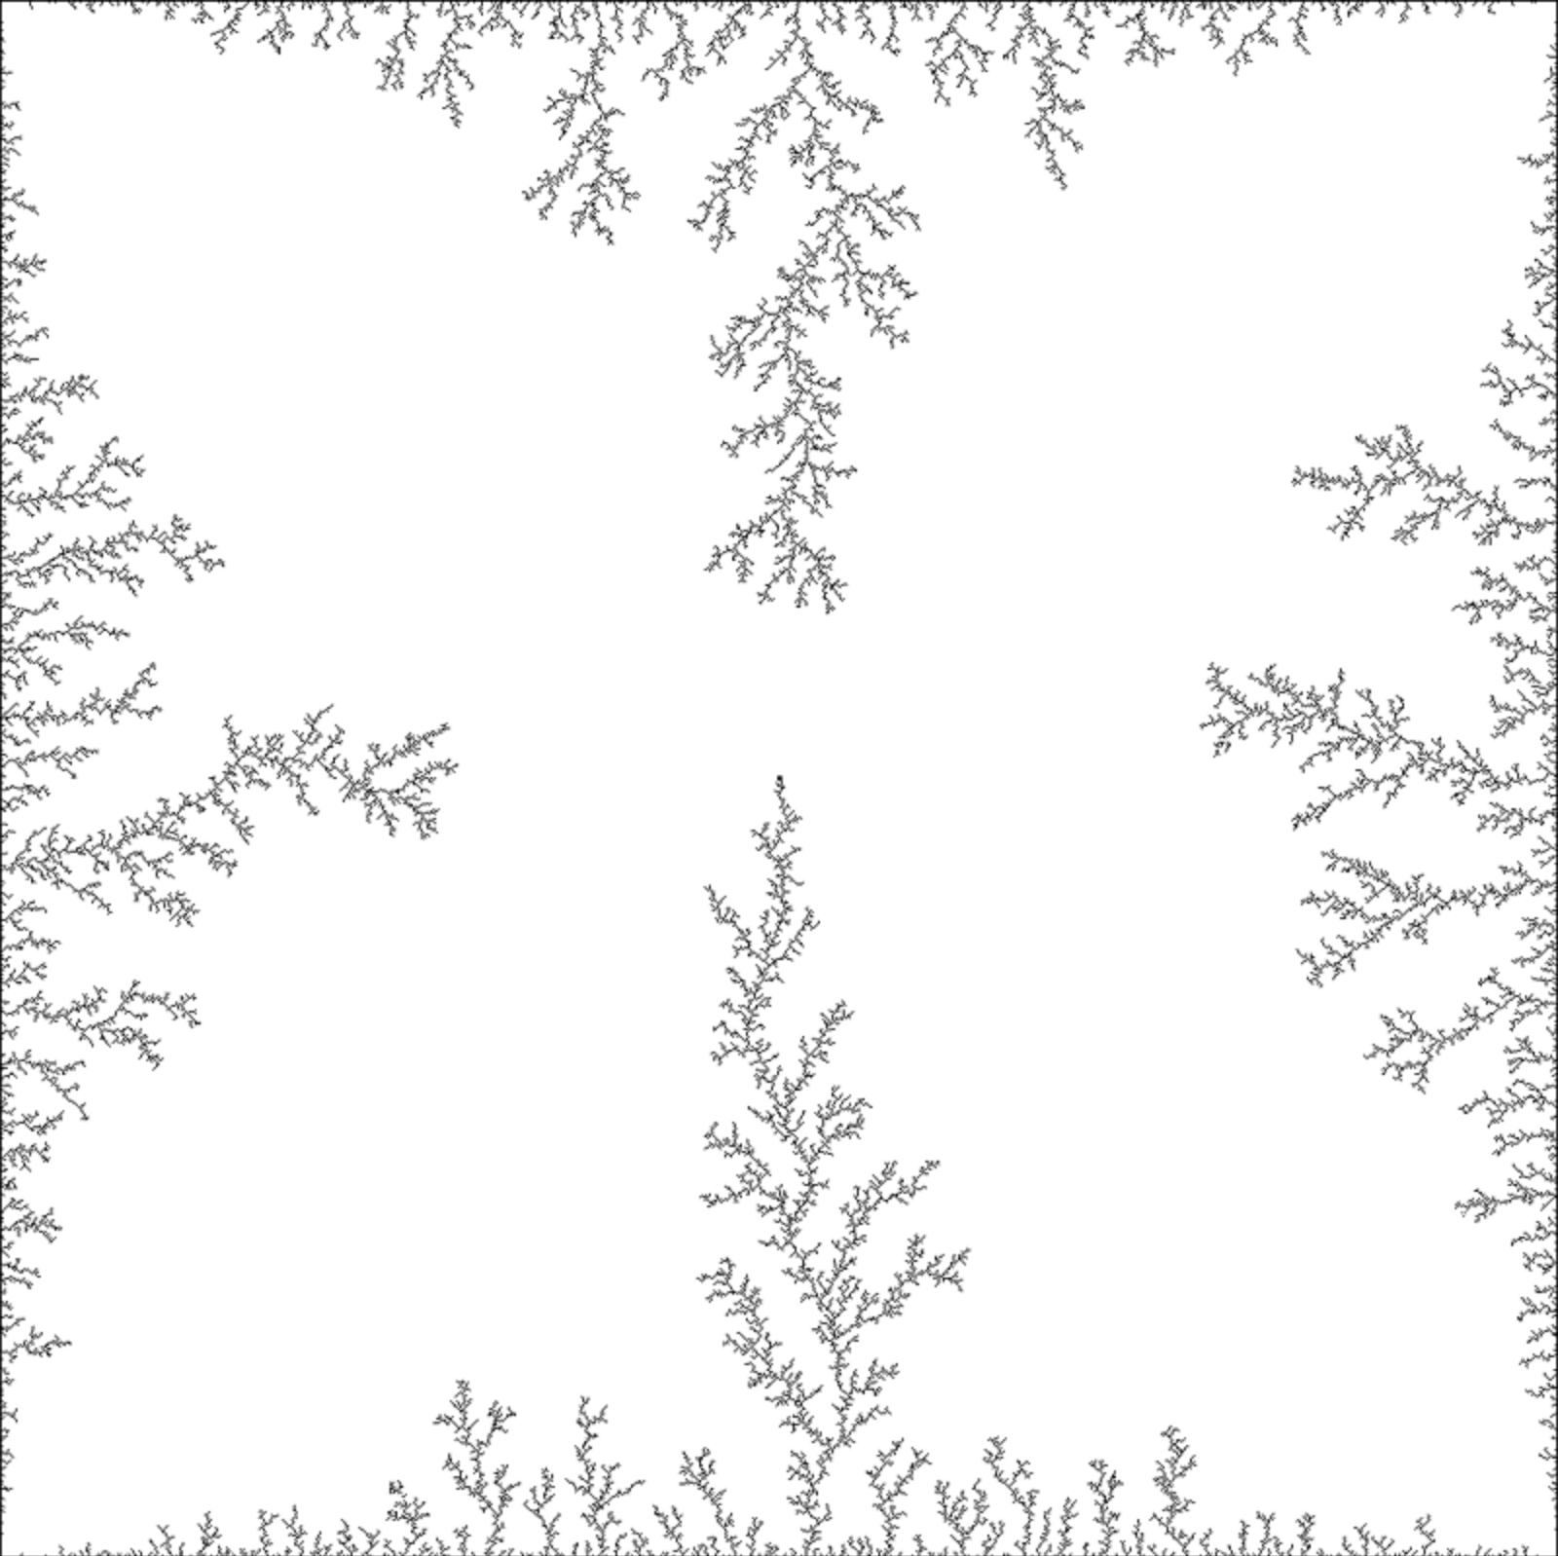
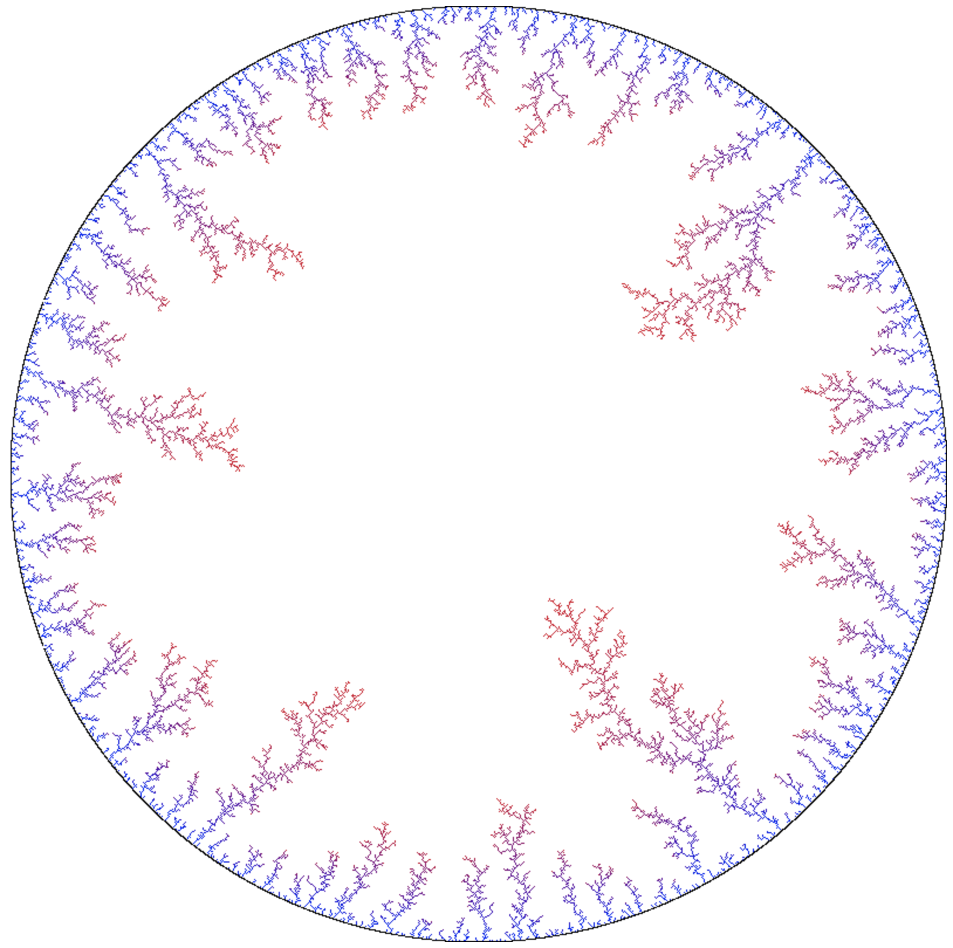
What is Diffusion Limited Aggregation (DLA)?
Process:
Randomly deposited molecules
Molecules randomly walk in space
Molecule randomly walking stick to other stuck molecules
Includes:
Different geometries of attractors
Changing particle size / multiple particle sizes
a
b
c
Figure 1: a) point attractor b) rectangular Attractor c) circular attractor
DLA - Diffusion Limited Aggregation (2020). Available at: http://paulbourke.net/fractals/dla/ (Accessed: 1 April 2020).
Notes:
Diffusion limited aggregation can make some pretty cool looking photos as shown in figure 1. But what is diffusion limited aggregation. The process begins with a deposited molecule, which can originate at the origin, on a surface, or randomly in space. Then, this molecule Randomly walks in space. When it reaches the seed molecule it sticks, in figure 1 that would be the origin, or in b and c the border of the enclosing surface. This process continues and molecules begin sticking to each other until images form like in figure 1. There are different geometries of Diffusion limited aggregation seed particles and also instances such as decreasing particles or particles of various sizes.

Slide 3
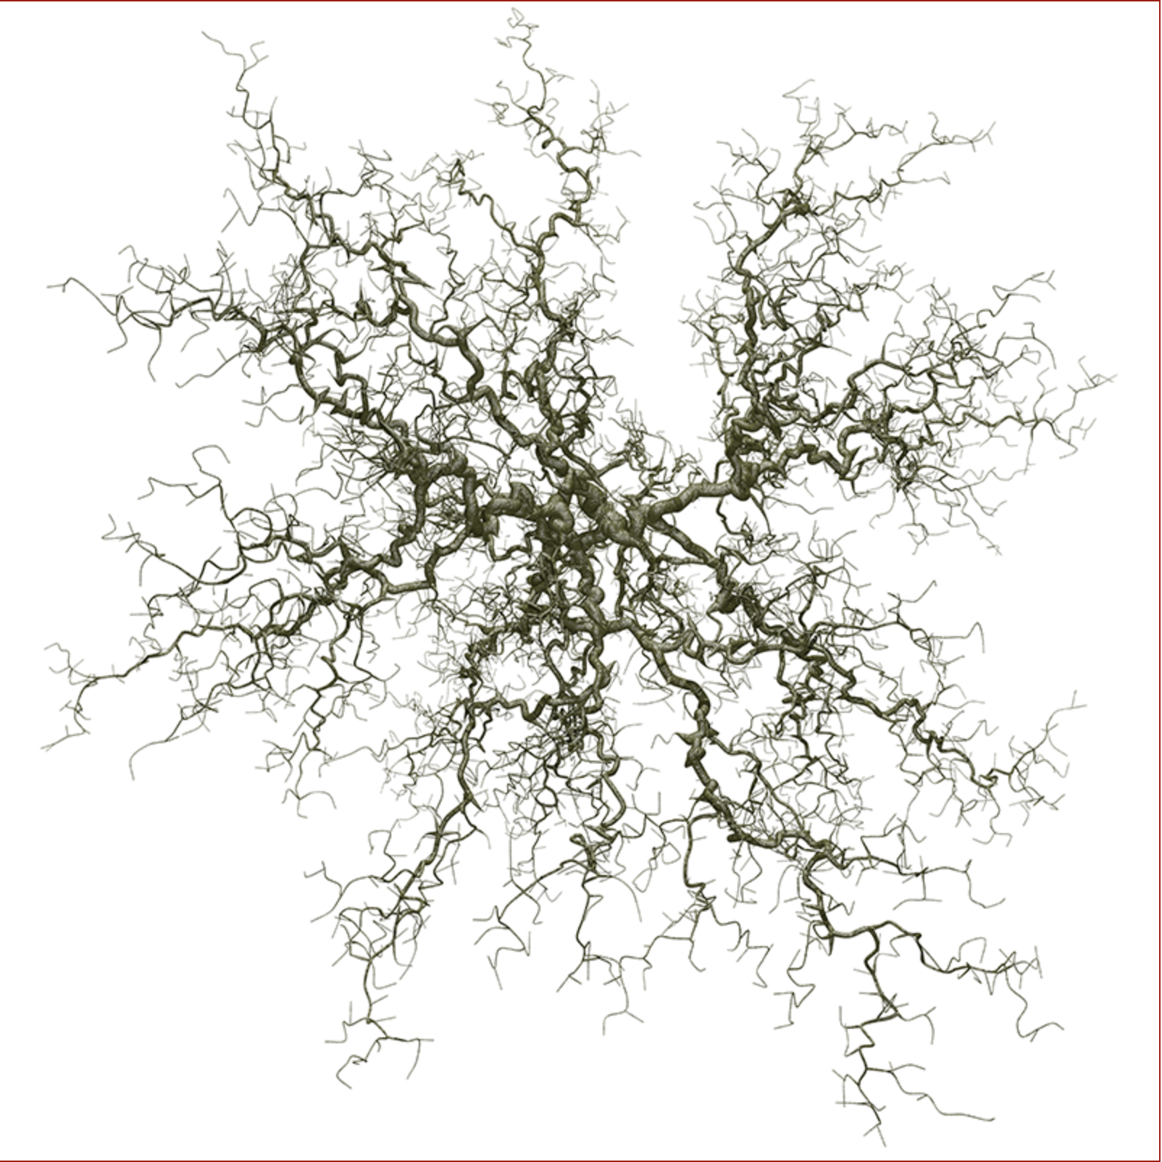
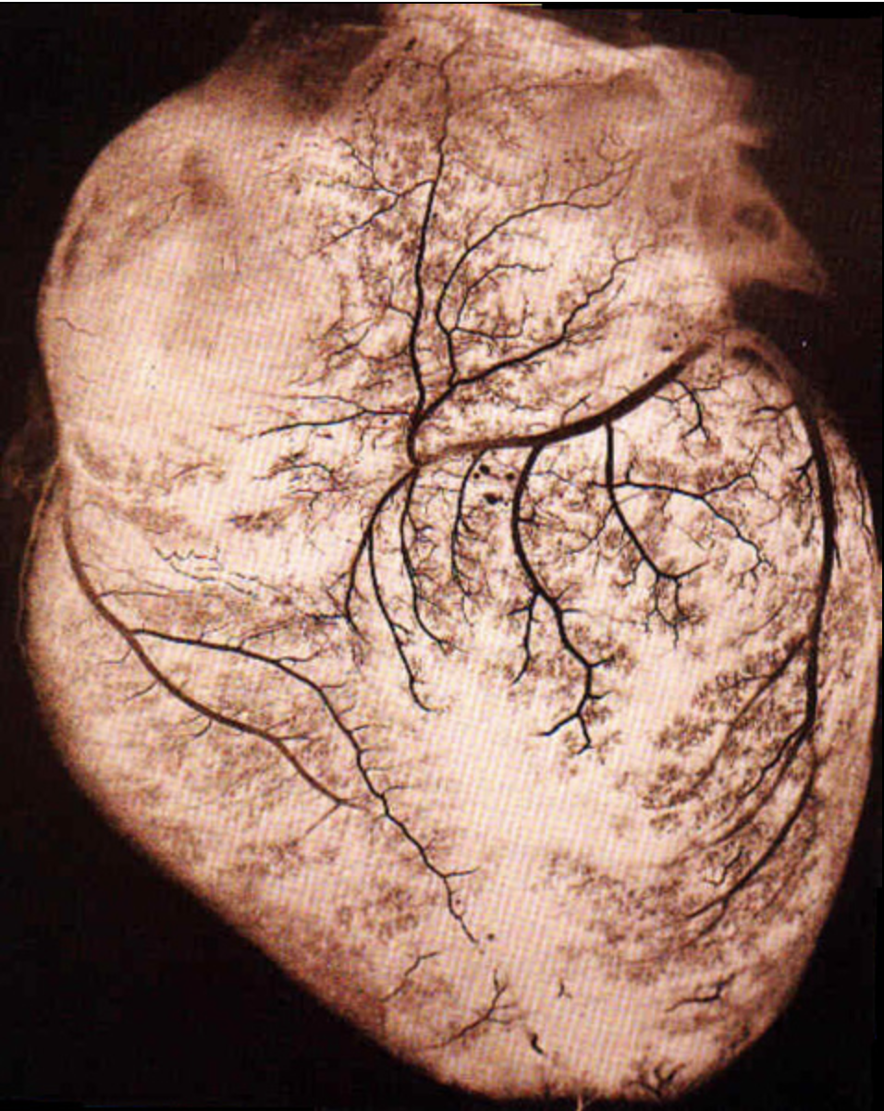
Applications of DLA
a
b
Condensed Matter/Solid State Physics
Chemistry
Biology
Figure 2: a) 3-D DLA with decreasing thickness b) A human heart
DLA - Diffusion Limited Aggregation (2020). Available at: http://paulbourke.net/fractals/dla/ (Accessed: 1 April 2020).
Notes:
DLA was first studied for its application to condensed matter physics or solid state physics. But the topic reaches all corners of science, from physics to chemistry to biology. The process of diffusion is all around us, how solids aggregate how, liquids transfer, how gases move. A quick google scholar search will provide 1,000,000 search results. Some of the titles are
Diffusion-limited aggregation and two-fluid displacements in porous media
A model could simulate how particles would diffuse from a 2d plane in three dimension and how the two fluids would interact
Chemically limited versus diffusion limited aggregation
Is a process limited chemically or by diffusion? DLA models could predict behaviour of a chemical system and see if its measurements agree with simulation
Diffusion-limited aggregation in two dimensions
Studied the aggregation of silica microspheres confined to two dimensions at an air water interface.
Diffusion-limited aggregation, a kinetic critical phenomenon
This described a model for random aggregates studied by computer simulation. The model is applicable to a metal-particle aggregation process whose correlations have been measured previously
Image a shows a DLA model in 3d with decreasing branching thickness, and from above it looks a lot like a tree, image b show a human heart with the blood vessels showing the ordered structure of diffusion limited aggregation we saw on the previous slide.

Slide 4
How Python Made This Easier
Python is a high level language
Object Oriented
Useful libraries with useful functions
Notes:
Why am I using pythonfor this problem? Besides the reason that we all have to it is the best I believe for this problem and I’ll explain why. Python is a high level language, the code you will eventually see will be understandable to even those of limited experience in python. This makes it easier to read and problem solve. Python is an object oriented programming language and this makes programming and problem solving errors easier because most of our errors will occur with an object class and its easily investigated. Using functions on objects simplifies analysis and can carry out complicated calculations easier than functional programming. Python also has useful libraries with lots of functions which make physical modelling easy. I used NumPy extensively for managing arrays and Matplotlib for all my plots.

Slide 5
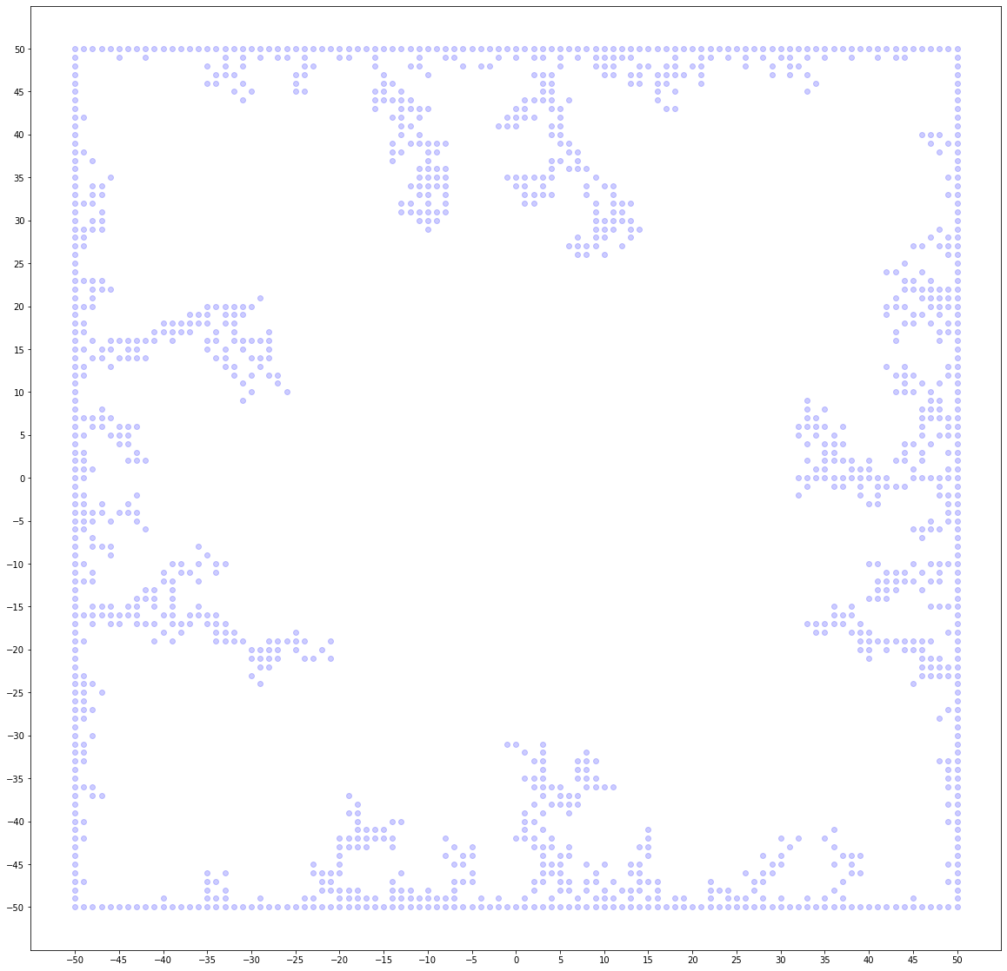
Methods and Procedure: Rectangular Attractor
Start
Make Particle Randomly Walk
False
Does Random Walker Hit Another Particle?
Add to Coordinates of Stuck Particles
Output Plot of Stuck Particles
True
Notes:
My project is focused on DLA and all the information I will be presenting today is on the rectangular attractor which you can see at the output at the top right. A particle starts at the origin with the seed particles on the border. The next step is for a particle to randomly walk. Does it hit another particle after its reached the maximum number of steps? If it doesn’t then another particle is released and it goes back into the loop. If it does stick then the coordinates are saved and the process continues. This will continue for a given number of particles or when a condition is reached such as a particle has reached the origin or the center of the plot.

Slide 6
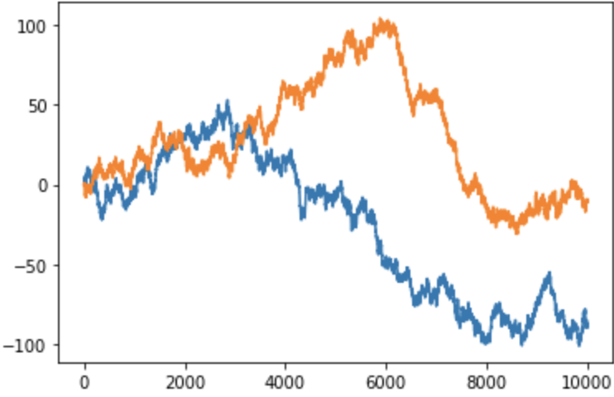
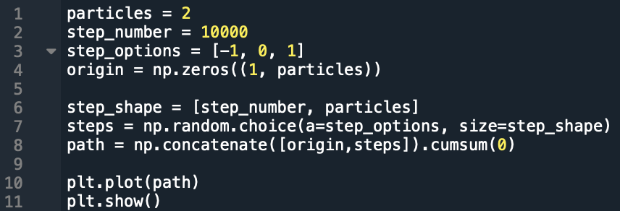
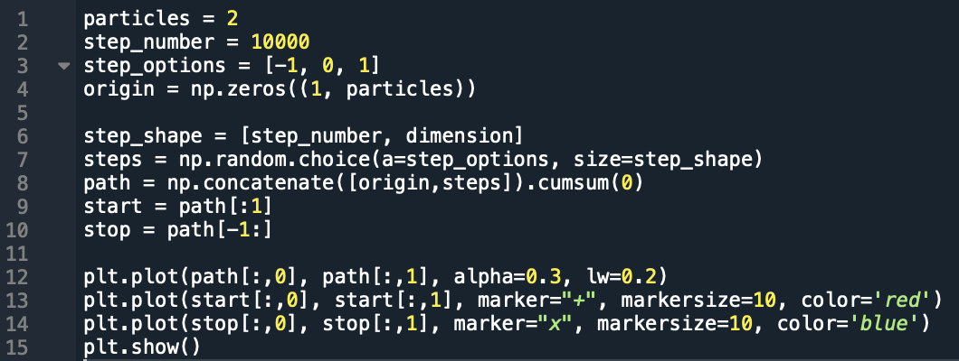
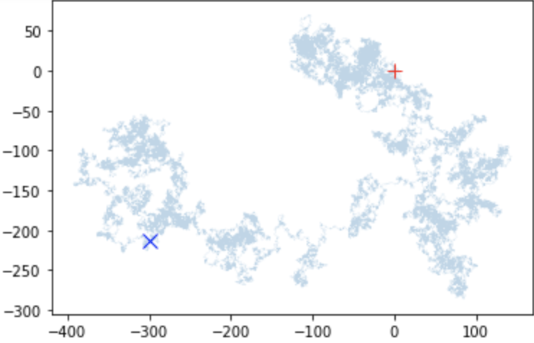
Process
Notes:
So far I have explained what DLA is what it is useful for and how you would program it. Now I’ll show you how I programmed a DLA simulation.
This is important to explain because generating this random walk it is the basis of my project.
In the first block of code I defined simple variables such as the particles, step number, the step options and the origin. The variable Step shape creates an array for the number of steps and particles in this case, 10000x2. The variable Steps choses a random number either -1,0,1 and stores it in the 10000x2 array. The variable path then takes the cumulative sum of all these values. By creating 2 such 1d arrays shown in the top image, we can combine them to make a 2d random walk one for the x and y coordinates which can travel in every direction, up down left right, diagonally, or not at all. We can see the output in the bottom image.

Slide 7
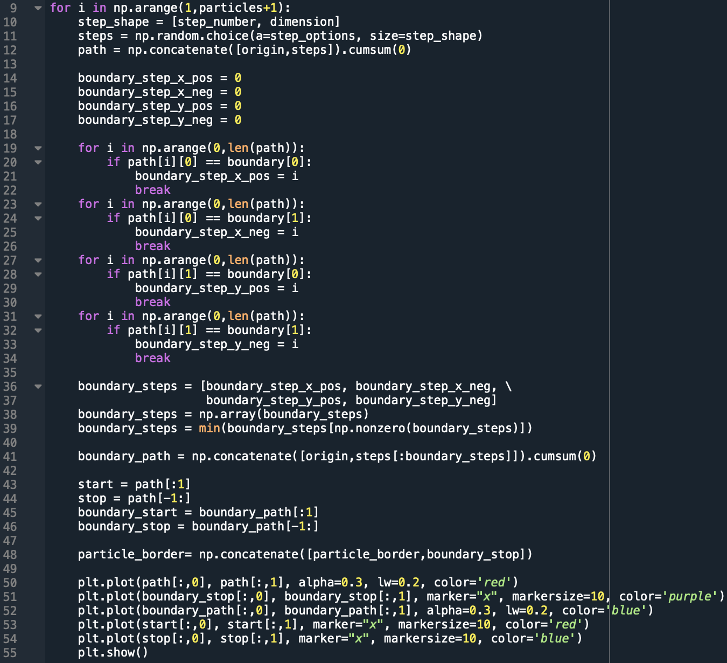
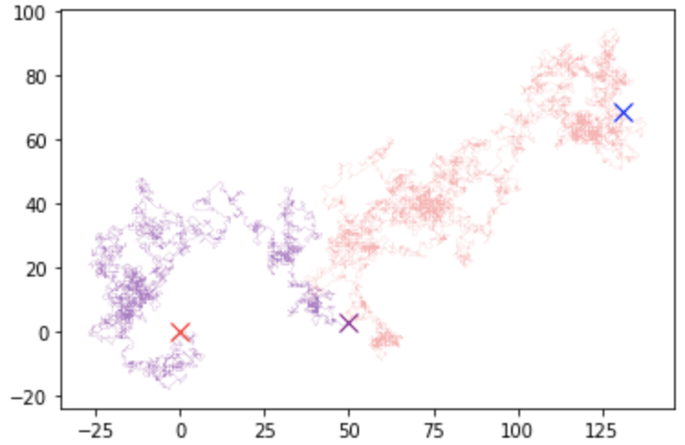
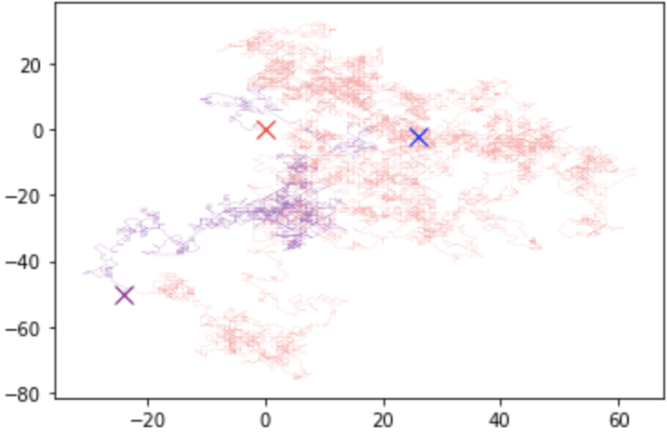
Notes:
I didn’t attack the problem at first in the best way but I believe it was a necessary step in understanding the problem. Here is the code I used to find when a random walk for a particle would cross a boundary I defined. I used the same initial variables and did this for 2 particles. The output is shown on the right. The red x marks the origin, the purple is the path to the defined boundary, it reaches at the purple x and the red path is where the particle would be if the particle continued through the boundary, the blue x marks the 10000 step. You can see this code is quite cumbersome for something as simple as saying “stop a random walk when it reaches a certain value”.

Slide 8
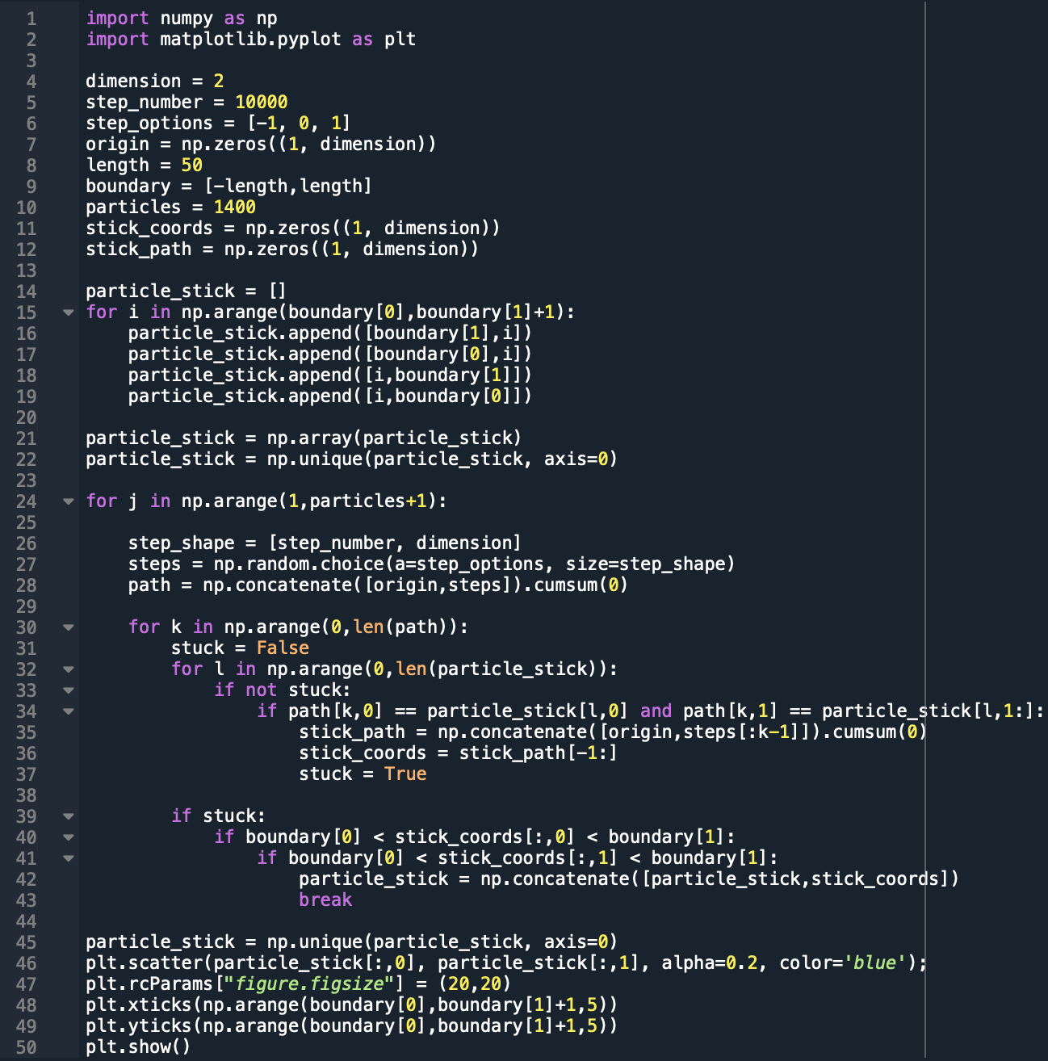
Start
Initialize Variables
Set Particles Along Border
Start Particle Randomly Walking
F
Does the path of particle touch an existing particle?
F
T
Does the position of the particles touching fall within the borders of interest?
T
Output Plot
Notes:
Learning from my mistakes I changed my programming structure to the following.
I initialize my variables the same as before and created empty arrays of zeros for those I will be concatenating.
I then created the seed particles for the border and put them in an array so a random walker would know if it had stuck to one of the coordinates.
Then the next step is to set particle randomly walking, and this next section is in a for loop so the next steps happen for the pre-set number of particles.
After this we consider does the path of a particle touch an existing particle? the array of the path is compared to the array particle_stick looking for the first value that both x and y coordinates are the same. If it matches the number of steps – 1 it took to get there is the path to an existing particle when it touches, we get the coordinates
Then I check the particle is within the correct boundary and that its not sticking to the wrong side of the boundary.
Once it’s looped over all the particles it outputs a plot of all the stuck particles.

Slide 9
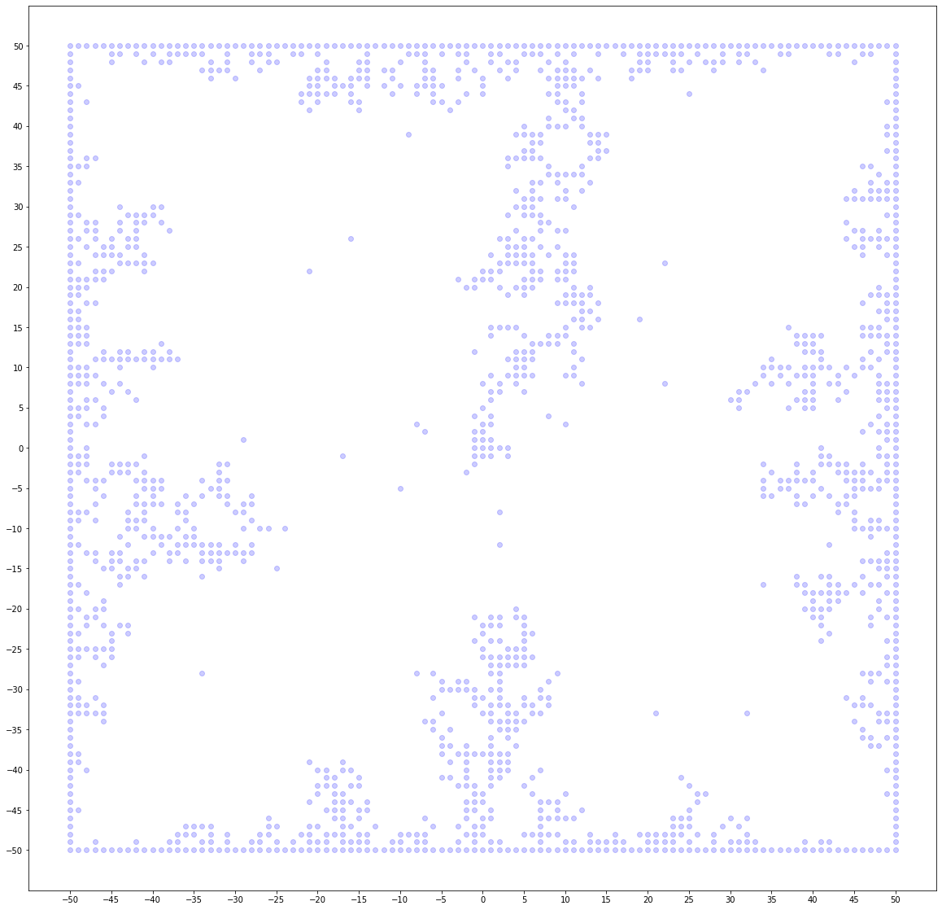
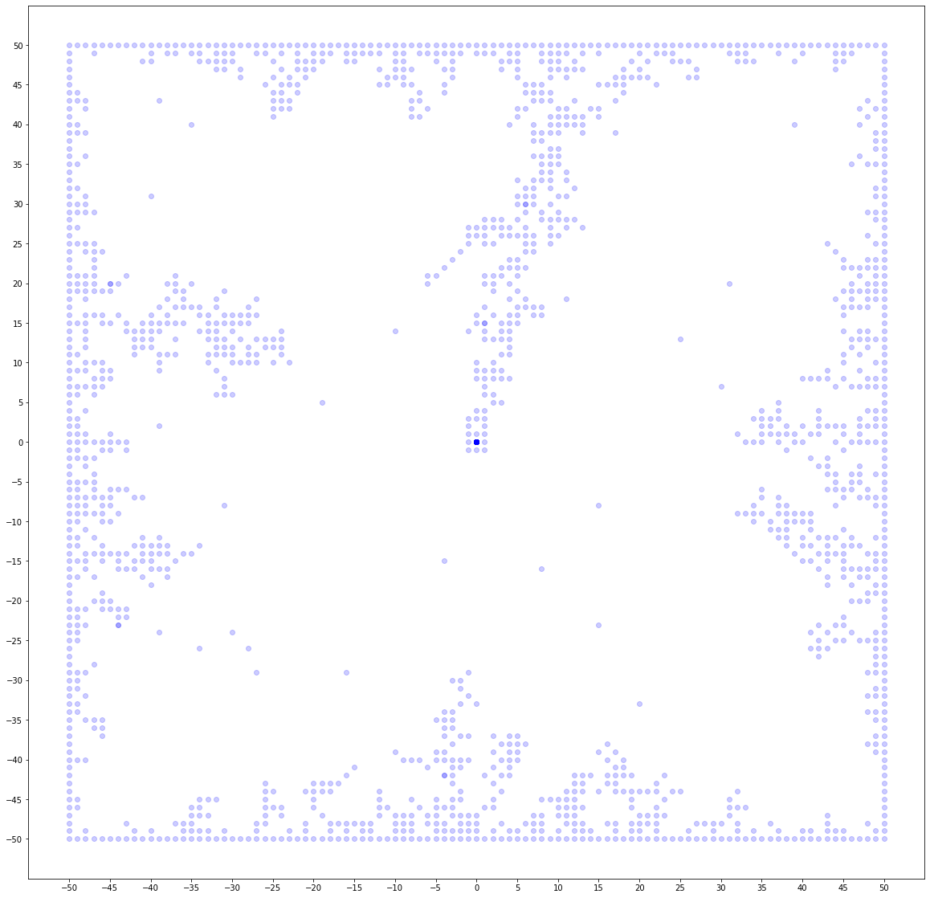
100x100 Plots with Varying Numbers of Particles
a
b
c
Figure 3: a) 1000 particles and 10,000 steps b) 1400 particles and 10,000 steps c) 1500 particles and 10,000 steps
These outputs are on a grid ranging between: (x,y)=([-50,50],[-50,50]) and shows behavior we would expect of diffusion limited aggregation.
Notes:
Well now we’re done with most of the programming challenges we can look at results. These plots are on a 100x100 grid all with differing numbers of particles. We see the ordered structure of a diffusion limited aggregation in figure 3. Image a is 1000, image b is 1400, and image c is 1500. I noticed a problem with my code when I got to this stage. If the particles reach the origin then the remaining particles “stick” in incorrectly in places as observed in image b and c. This could be fixed by replacing my large for loop with a while loop with a condition to stop when the stuck particles reach the origin. The computation time here doubled for the number of particles. It took 16 mins for image a and roughly 30 mins for image b and c. so this isn’t exactly a fast program with all of my long loops comparing values of the path and stuck particles.

Slide 10
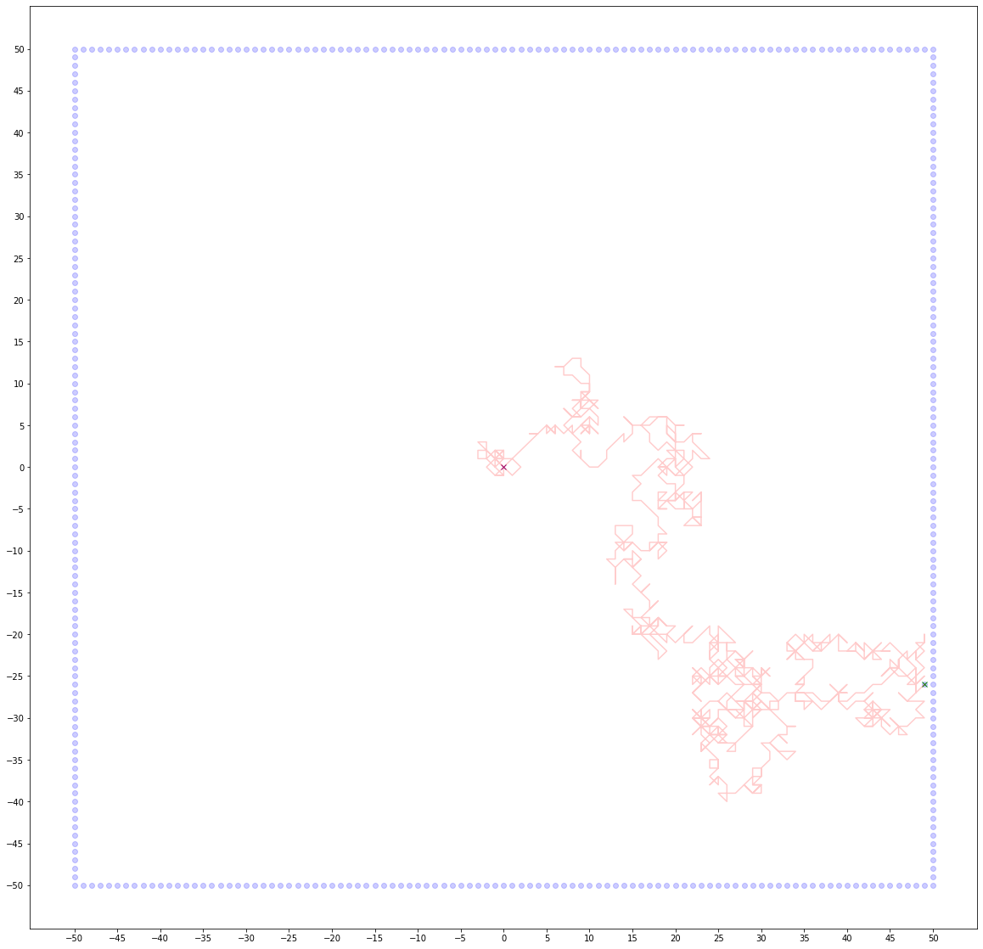
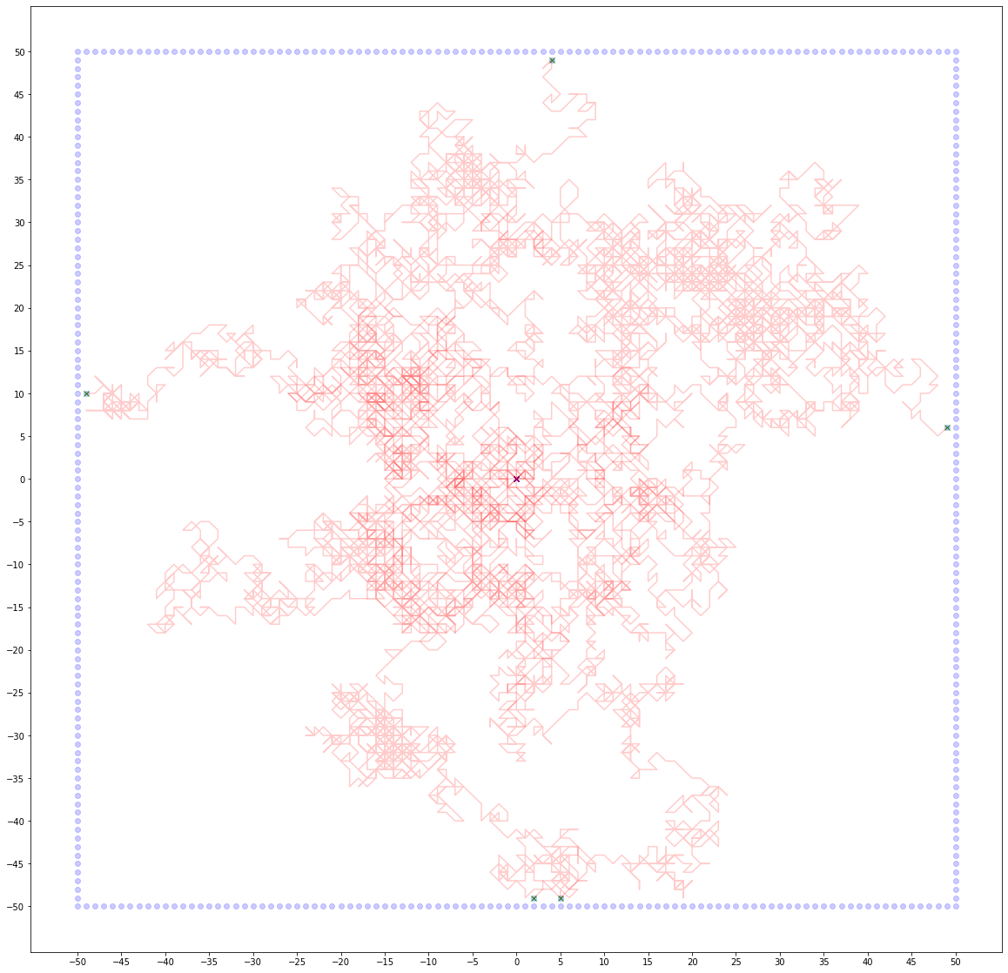
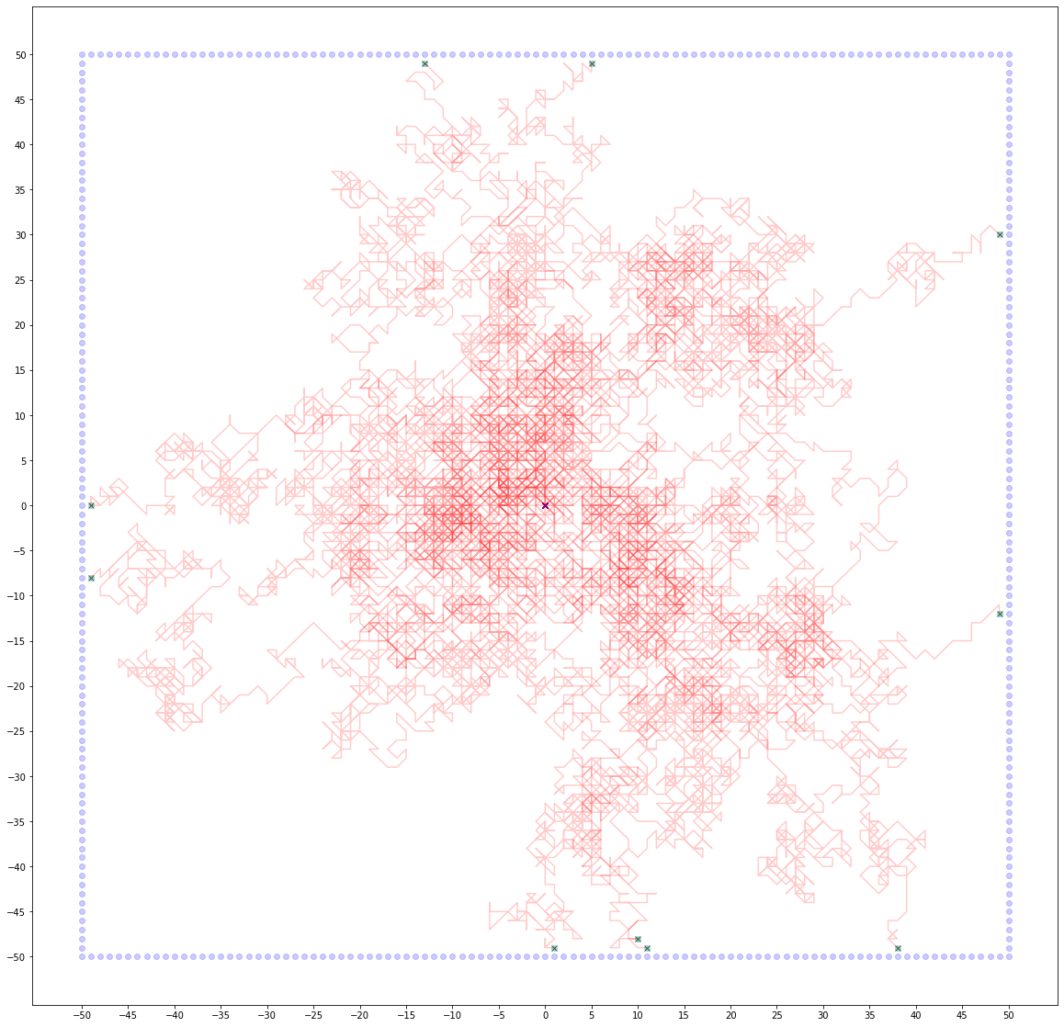
100x100 Plotted Paths with Varying Numbers of Particles
a
b
c
Figure 4: a) 1 particle b) 5 particles c) 10 particles
These outputs are on a grid ranging between: (x,y)=([-50,50],[-50,50])
Notes:
I’ve shown here how the images were obtained on the earlier slide with the path to the seed particles shown. This demonstrates how complex the program is, the computer had to do this 10000 times for the images on the previous slide. We can see the complexity increase from image a and 1 particle to image c and 10. There are lots of values for the computer to keep track of.

Slide 11
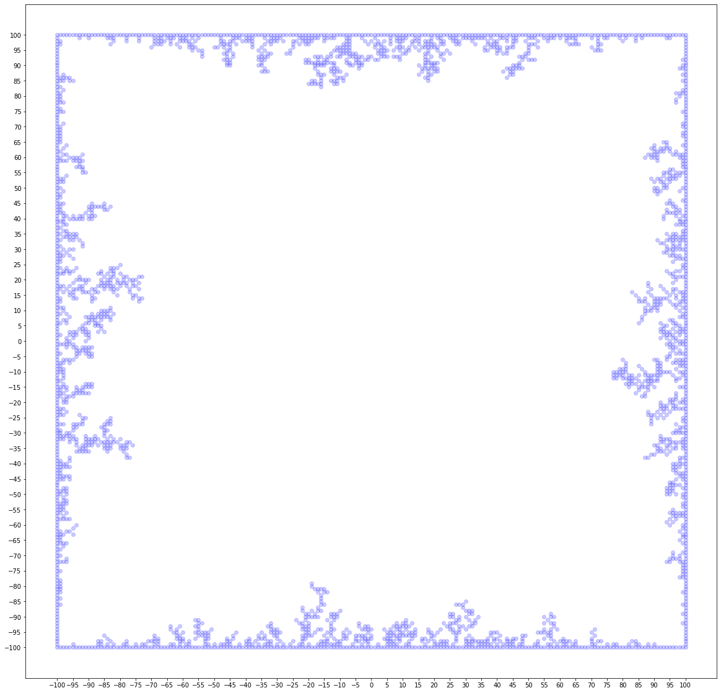
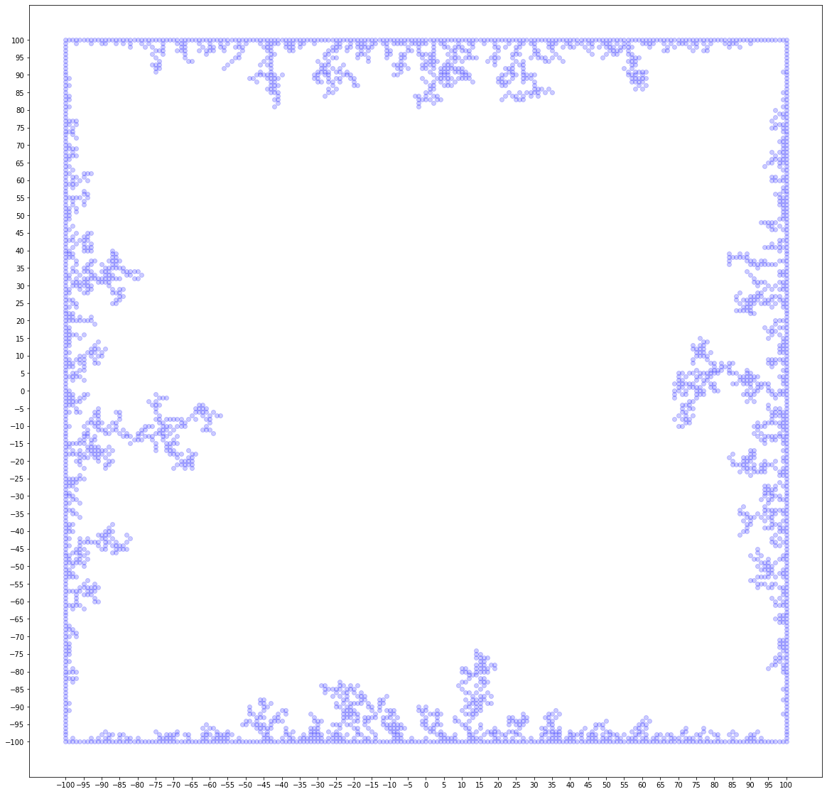
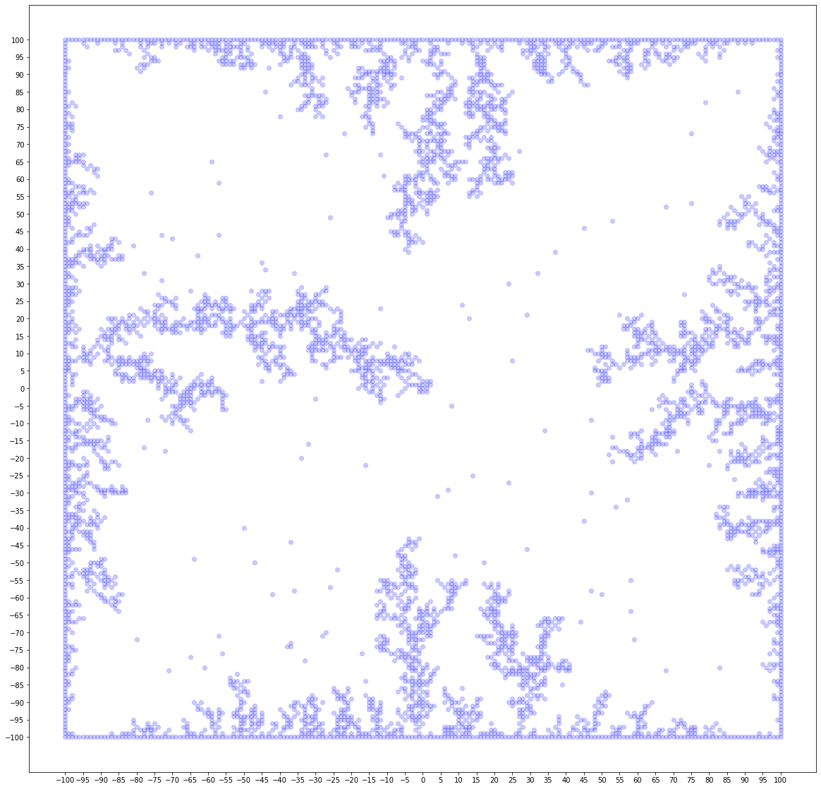
100x100 Plots with Varying Numbers of Particles
Figure 5: a) 2400 particles and 10,000 steps b) 2400 particles and 30,000 steps c) 4800 particles and 30,000 steps
These outputs are on a grid ranging between: (x,y)=([-100,100],[-100,100])
Notes:
Now we get to the best images I’ve obtained. These images also revealed interesting characteristics about the speed of my program. I strategically chose the values of the particles and steps. From image a to image b there was an increase of 20,000 steps and virtually no increase in computational time. However from image b to c the number of particles doubled and the computational time doubled as well. Image a took 5 hours, image b took 5 hours and image c took ten hours plus or minus less than 10 mins. This was actually quite an interesting result, because this would imply that although my program is slow it was working on linear time. Increasing the step count has no real effect on computational time because the program stops the path of the particle when it gets to the border, so running the program with a step number that’s really high will not matter because those extra steps will not be included in the loop. Increasing the particles however does increase the time linearly. Doubling the particles doubles the length of the for loop. One thing I will try to do in the future is minimize computational time and replace my for loop with a while loop, which is easier said than done.

Slide 12
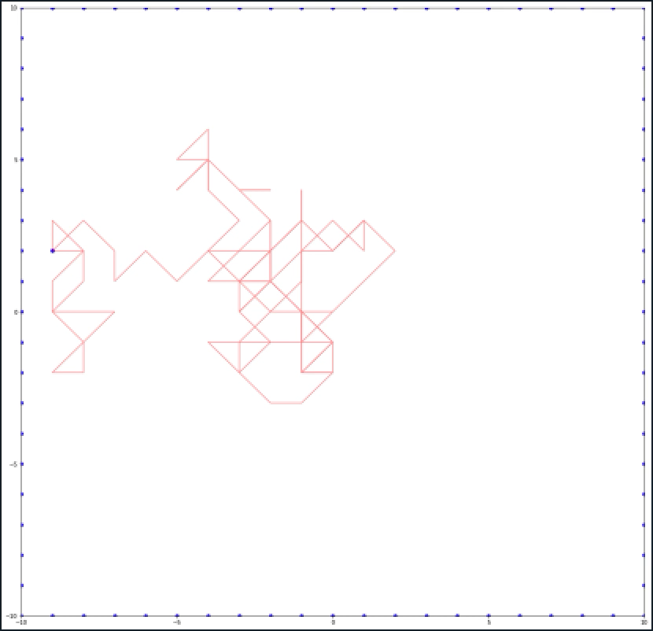
Animation
Figure 5: Animation of a single Particle sticking on a 20x20 grid
Notes:
Here I’ve created an animation of one particle doing a random walk. I’m afraid doing it for multiple isn’t as interesting at the current speed because they walk iteratively.
Press play
Imagine all the things the computer has to do at each step, search a 10000x2 array for a common value with the boundary coordinates, calculate its next step, and search again, look at the motion of the particle and see how weird it is that the ordered structure of that which we saw on the earlier slides of diffusion limited aggregation come out of repeated iterations of this random motion. Imagine how you would program such a task.

Slide 13
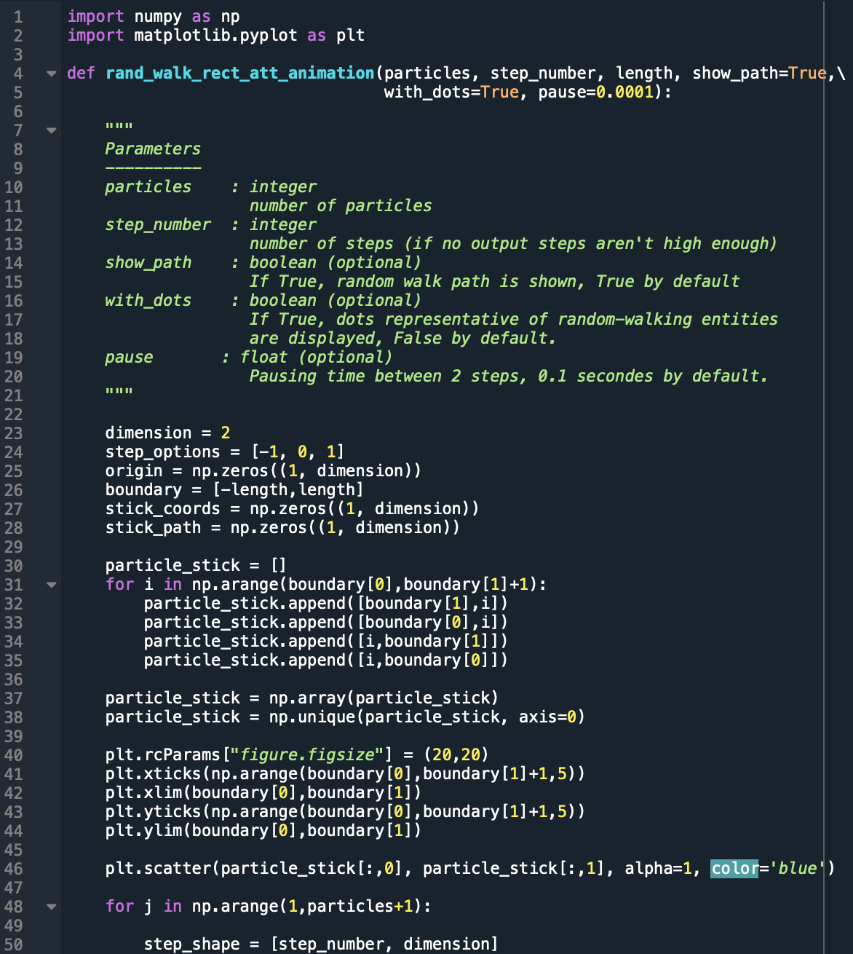
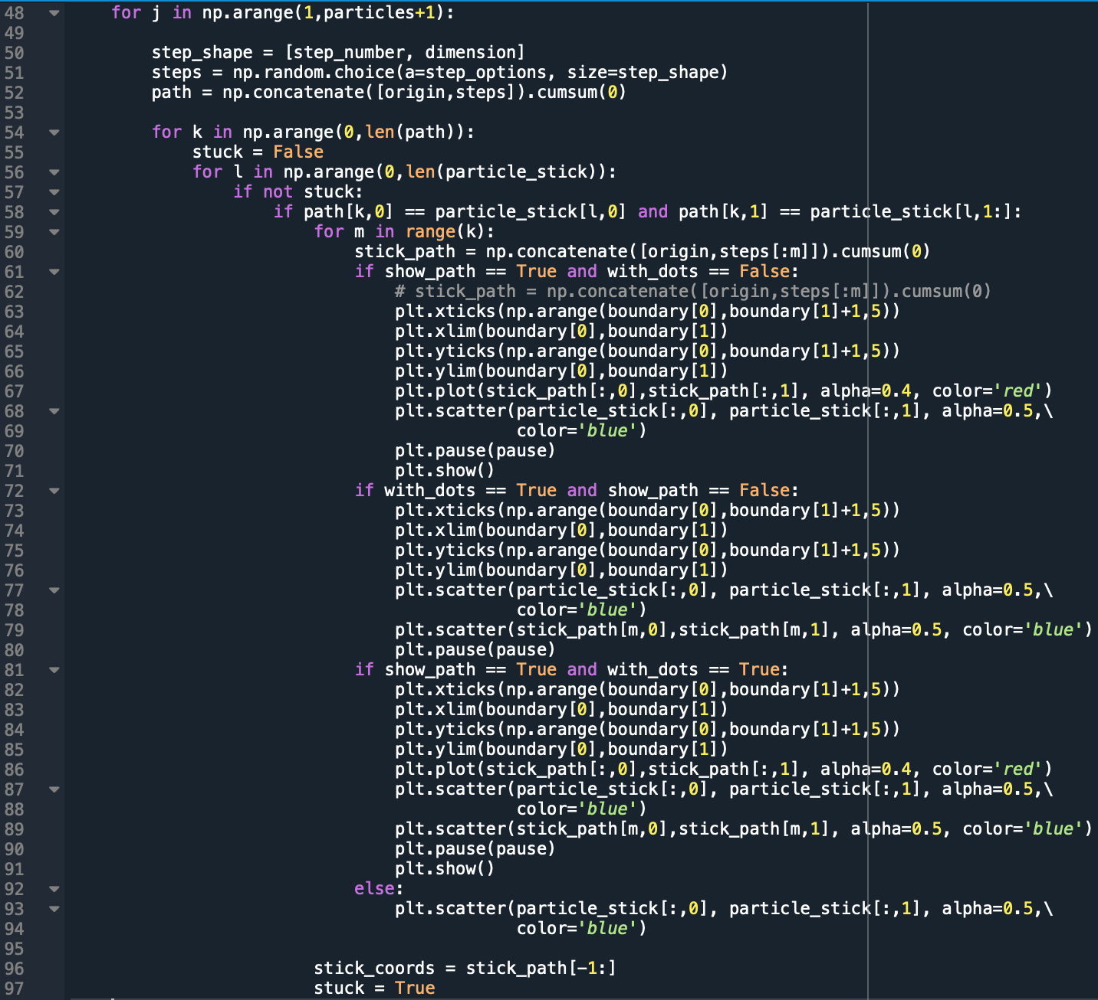
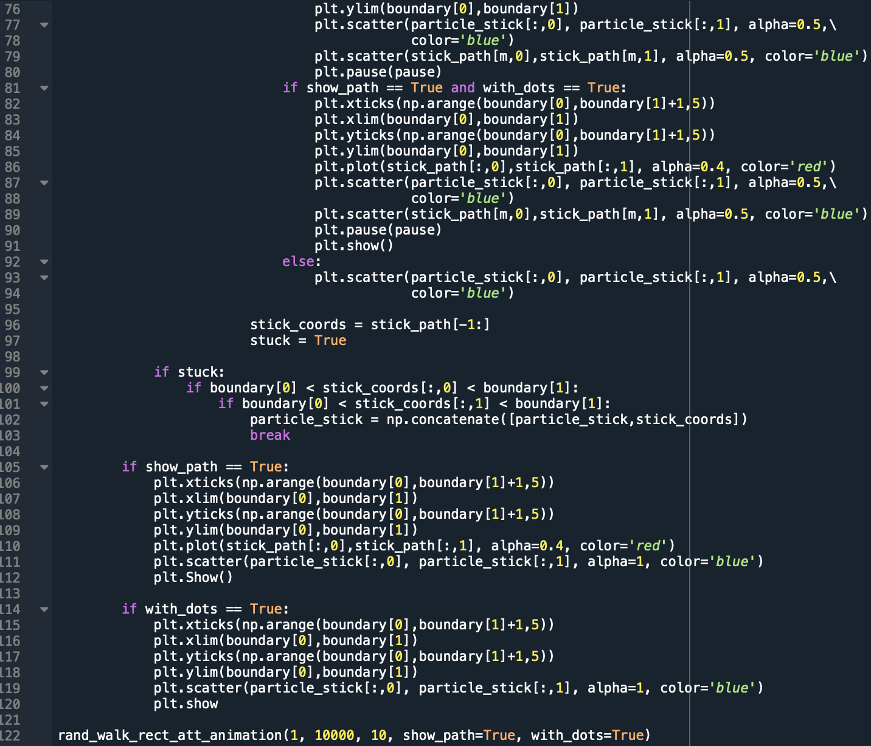
Notes:
If youre curious how I completed that animation it took a lot of work for such a simple video, here is my code. It is a lot but parts are familiar if you we’re paying attention earlier. I made the animation frame by frame for each step the particle took.

Slide 14
Next Steps
Decrease computation time
Convert program to a while loop
Different geometry of attractor
A full simulation of an outputted plot
3D geometry
Notes:
I know you didn’t want to stare at that longer than you had to so I will continue by talking about the things I would like to accomplish with this program:
I want to Decrease computational time, Ian has helped me look into possible places to do this
I’d also like to Convert program to a while loop to remove the irregularities we saw on the DLA simulation
Looking a Different geometries of attractors, such as a the point attractor we saw on the first slide would be really interesting
As well A full simulation of an outputted plot, would be really interesting to see at high speed, there is only one way to find out
I if can make this problem manageable with 3D geometry I’d like to try, it is possible and I tested it already for low numbers of particles however until I decrease computational time it is beyond my patience limit to wait for the program

Slide 15
Conclusion
DLA has many different applications
Creating a fast program is not easy
Excited to see more applications!
Notes:
Thanks a lot I hope you’re interested in diffusion limited aggregation now! do you have any questions??

Slide 16
Thank You! Questions?

